Slide 1

Predicting the Future Price of S&P 500 index
David Meiners
Bellevue University
Summer 2021

Slide 2
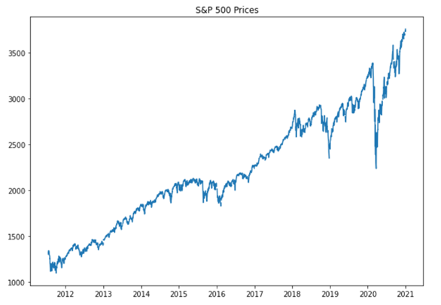
Introduction
Investors are looking to maintain wealth through investing
S&P 500 historically has double every 10 years
Inflation averages at 3% annually

Slide 3
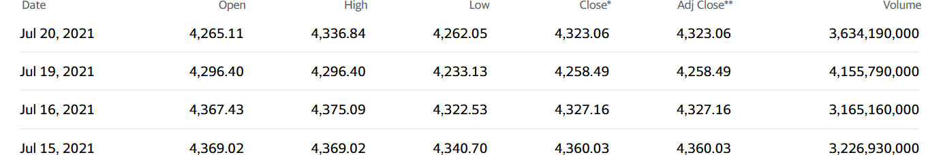
Data Source – Yahoo Financial
Provides historic and near real time data on price of S&P 500
Data source is reliable and includes metrics for various price values and volume for each day
Premium access provides more metrics to assist in investor analysis

Slide 4
Research Questions
Will the S&P increase in value over the next two months?
Based on current trends should an investor buy, hold, or sell their current investment?

Slide 5
Prediction Model – Neural Prophet
Open Source timeseries forecasting library
Easily allows for autoregressive approach and handling seasonality
Built functions to handle outliers and missing values
Allows for tuning of neural network including hidden layers

Slide 6
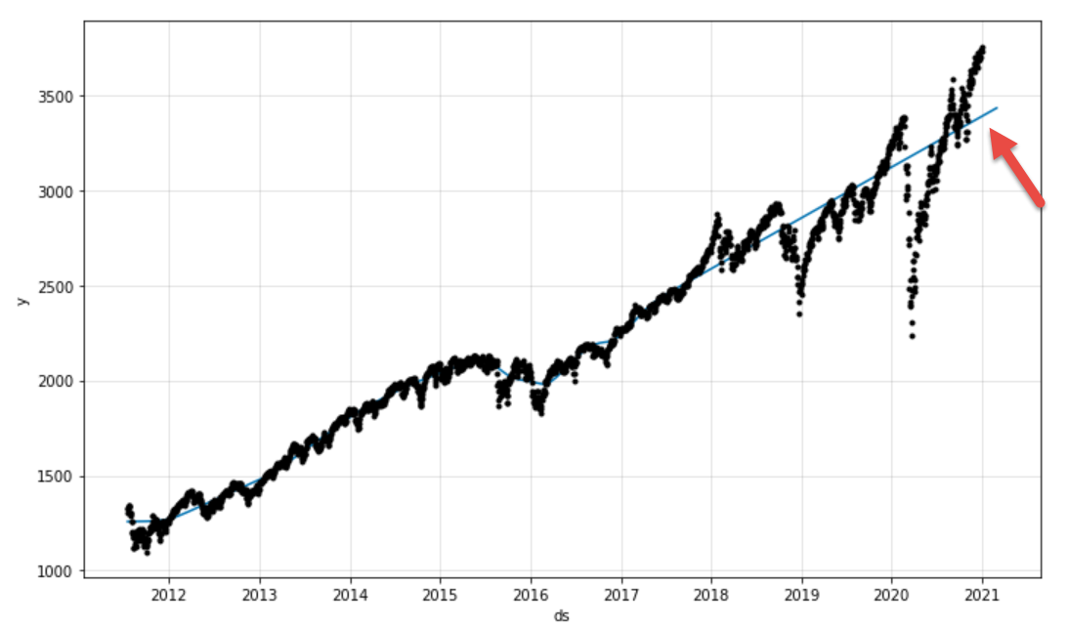
Prediction Model Under Fit

Slide 7
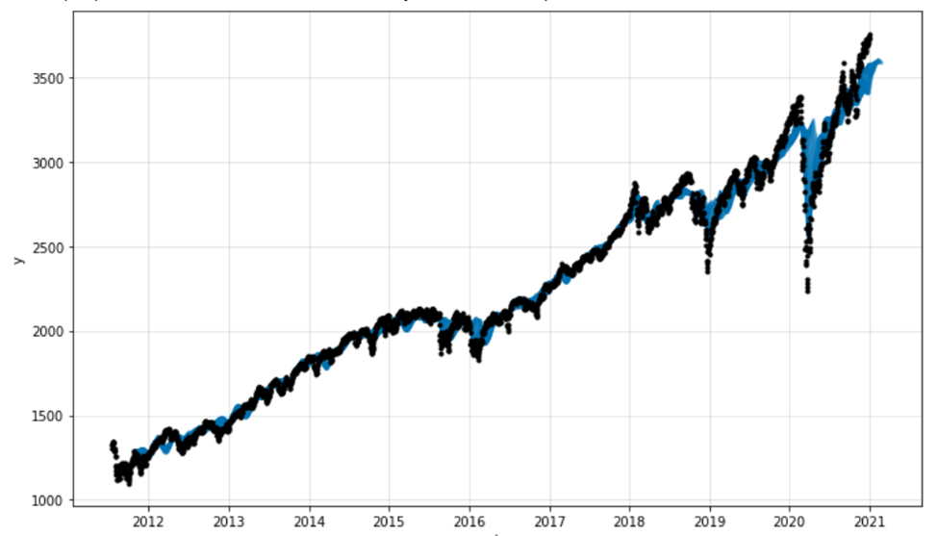
Final Prediction Fit

Slide 8
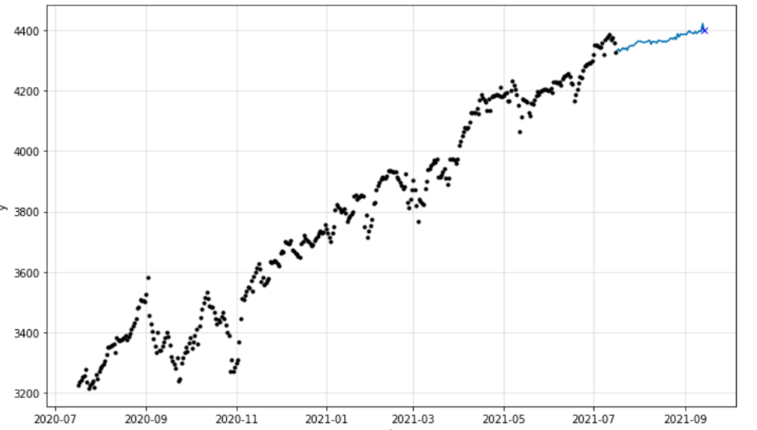
S&P 60-day Forecast

Slide 9
Will the S&P increase in value over the next two months?
Model predicts a slight upward trend at 1.5% over the next 60 days
Final estimate is 4400 points with value briefly exceeding this value

Slide 10
Based on current trends should an investor buy, hold, or sell their current investment?
1.5% increase is slightly under what one would expect from S&P 500 at 9% annual growth which is slight below average of 10%
Other financial assets may have better short-term outlook compared to S&P 500 but likely with increased risk due to volatility
Investors desiring low risk and long-term growth should hold and considering buying shares in index fund

Slide 11
Considerations
Market can change rapidly due to unforeseen events
Trend should be monitored daily and model reexecuted to ensure model identifies same upward trajectory
Long-term investors should be less concern with market volatility

Slide 12
Conclusion
Neural Prophet model indicates an increase of 1.5% over the next two months which is on par with what one would expect from this index fund
1
Markets are highly volatile and be monitored closely for short-term investors
2
S&P 500 is a great way to diversify into many assets while keeping risk relatively low for long term investors
3

Slide 13
References
Budiharto, W. (2021, March 11). Data science approach to stock prices forecasting in Indonesia during Covid-19 using Long Short-Term Memory (LSTM). Journal of Big Data. https:Vijh, M., Chandola, D., Tikkiwal, V. A., & Kumar, A. (2020, April 16). Stock Closing Price Prediction using Machine Learning Techniques. Procedia Computer Science. https://www.sciencedirect.com/science/article/pii/S1877050920307924.
//link.springer.com/article/10.1186/s40537-021-00430-0.
Predicting Stock Prices Using Machine Learning Techniques. IEEE Xplore. (n.d.). https://ieeexplore.ieee.org/abstract/document/9358537.
Enhancing Profit by Predicting Stock Prices using Deep Neural Networks. IEEE Xplore. (n.d.). https://ieeexplore.ieee.org/abstract/document/8995189.
Zahedi, J., & Rounaghi, M. M. (2015, July 9). Application of artificial neural network models and principal component analysis method in predicting stock prices on Tehran Stock Exchange. Physica A: Statistical Mechanics and its Applications. https://www.sciencedirect.com/science/article/abs/pii/S0378437115005932.
Henrique, B. M., Sobreiro, V. A., & Kimura, H. (2018, April 27). Stock price prediction using support vector regression on daily and up to the minute prices. The Journal of Finance and Data Science. https://www.sciencedirect.com/science/article/pii/S2405918818300060.
Kalyoncu, S., Jamil, A., Karataş, E., Rasheed, J., & Djeddi, C. (n.d.). Stock Market Value Prediction using Deep Learning. Data Science and Applications. http://www.jdatasci.com/index.php/jdatasci/article/view/42.
Applying long short term momory neural networks for predicting stock closing price. IEEE Xplore. (n.d.). https://ieeexplore.ieee.org/abstract/document/8342981.
Kim, T., & Kim, H. Y. (n.d.). Forecasting stock prices with a feature fusion LSTM-CNN model using different representations of the same data. PLOS ONE. https://journals.plos.org/plosone/article?id=10.1371%2Fjournal.pone.0212320.
Zhang, J., Li, L., & Chen, W. (2020, July 20). Predicting Stock Price Using Two-Stage Machine Learning Techniques. Computational Economics. https://link.springer.com/article/10.1007/s10614-020-10013-5.

